Slide 1
Java and Security in Distributed Systems

Slide 2
What is Java?
Structured programming language
Object oriented programming language
Popular language for internet based applications
Java Applets - interpreted scripting language plugs into web browsers
Byte code and the Java Virtual Machine (JVM) encourages portability

Slide 3
Why is Java so Sucessful?
Its free
Its simpler than C++
Widely deployed
Open development

Slide 4
Observations
The Java language has no inherent support for communication or distributed systems
Java does have extensive packages (libraries) for user interfaces, communication and distributed systems
Java provides a platform for global development

Slide 5
Java in Distributed Systems
Remote Method Invocation
Jini
JavaSpaces
Java Management Extensions (JMX)
Interaction with CORBA

Slide 6
Java Web Services
Builds on existing standards and services
Java servlets deliver dynamic content
Java Server Pages (JSP)
XML
Simple Object Access Protocol

Slide 7
Enterprise Java
Sandbox security model
Java Cryptography Extensions (JCE)
Java Secure Socket Extensions (JSSE)
Java Authentication and Authorization Services (JAAS)

Slide 8
JavaBeans Component Model
A Java Bean is a reuseable software component
A component assembler allows components to the linked together e.g. Sun Microsystems Forte
The component assembler needs to know the detail of service components provided rather than the implementation details

Slide 9
JavaBeans Component Model (2)
Implementation of the serializable interface means that a JavaBean can be customised, saved and reused.
JavaBeans are normally stored in Java Archive files (JAR) which in turn contain a manifest file that describes the components in the jar file.
When a jar file containing a bean is loaded the manifest is read, allowing the IDE to display the classes visually.

Slide 10
JavaBeans Component Model (3)
Certain method naming conventions are used to enable properties to be implicit e.g.
  public void setProperty1 (int value) { … }
  public int getProperty1( ) { … }
Alternatively the BeanInfo class can be used to describe to the builder how the features should be presented to the programmer.

Slide 11
Security
Privacy
Integrity
Authentication
Authorization
Nonrepudiation

Slide 12
Privacy
Ensuring that information passed over the Internet has not been captured or passed on to a third party

Slide 13
Integrity
Ensuring the information sent has not been compromised or altered

Slide 14
Authentication
How do the sender and receiver prove their identities to each other

Slide 15
Authorization
Ensuring users only get access to resources they have rights to

Slide 16
Nonrepudiation
Providing proof that a message was sent or received

Slide 17
Cryptography (1)
Cryptography - Transforms data by using a cipher or cryptosystem (typically a mathematical algorithm)
The key, a string of alphanumeric characters that act as a password, is input to the cipher.
The cipher uses the key to make the data incomprehensible to all but the sender and intended receivers

Slide 18
Cryptography (2)
ciphertext – encrypted data
plaintext – unencrypted data
Different keys result in different ciphertext.

Slide 19
Cryptography (3)
Substitution ciphers
  every given letter is replaced by a different letter e.g. if every letter is replaced by the letter three positions on (caesar cipher)
  security becomes vhfxulwb
Transposition ciphers
  Modify the order of the letters e.g. split one word into 2, odd ordered letters into the first word and even into the second:
  security becomes scrt euiy

Slide 20
Cryptography (4)
Traditional encryption relied on the algorithm being memorised and kept secret.
Modern encryption relies on the keys being kept secret as the algorithms are in the public domain.

Slide 21
Cryptography (5)
Modern cryptosystems are digital and are based on bits or groups of bits (blocks).
Encryption and decryption keys are binary strings with a given key length e.g. 128 bits
The longer the key length the more difficult the key is to crack.

Slide 22
Secret-key Cryptography (1)
aka symmetric cryptography
A secret key is shared by both the sender and receiver. The same key is used to encode and decode the message.
Secure way to share the key is needed e.g. courier delivery
A different key is needed for every receiver

Slide 23
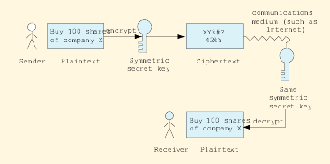
Secret-key Cryptography (2)

Slide 24
Secret-key Cryptography (3)
A key distribution center (kdc) may be used to solve the key distribution problem.
The kdc shares a key with every user on the system.
The kdc generates a new key for every session and sends it to the sender and receiver, encrypted by their respective keys.
The sender and receiver de-crypt the session key with the key shared with the kdc.

Slide 25
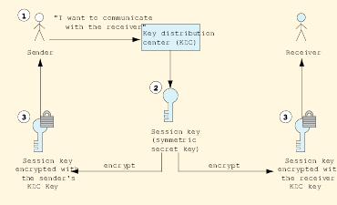
Secret-key Cryptography (4)

Slide 26
Secret-key Cryptography (5)
Data Encryption Standard (DES) is the most common symmetric encryption algorithms:
  Developed in the 1970’s
  Key length 56 bits
  Encrypts data in 64 bit blocks (block cipher)
  No longer considered secure and can be cracked in a few hours using late 1990’s technology
  Triple DES (3 DES encryptions in series with 3 different keys) replaced the original DES.

Slide 27
Secret-key Cryptography (6)
Advanced Encryption Standard (AES) is now being used as a replacement for DES:
  Key and block sizes of 128, 192 and 256 bits
  Chosen over four other algorithms
  See csrc.nist.gov/encryption/aes

Slide 28
Public Key Cryptography (1)
Initially developed at Stanford by Whitfield Diffie and Martin Hellman in 1976
Solves the problem of exchanging keys securely.
Asymmetric – uses two inversely related keys: a public key and a private key

Slide 29
Public Key Cryptography (2)
The sender uses the public key to encrypt a message and the receiver uses the secret private key to de-crypt the messages.
The public key can be freely distributed.
It is computationally infeasible to deduce the private key from the public key.
The two keys are mathematically related but to derive one from the other would take enormous resources.

Slide 30
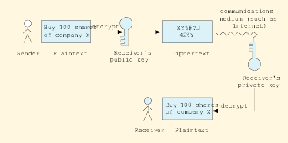
Public Key Cryptography (3)

Slide 31
Public Key Cryptography (4)
Either the public key or the private key can be used to encrypt or decrypt a message.
If the encryption key is the senders private key, and the receiver decodes it using the senders public key. Then the receiver has authenticated the sender.

Slide 32
Public Key Cryptography (5)
To provide two way authentication:
  Sender encodes message using receivers public key
  Then the sender encodes the (encoded) message using its own private key, and sends the message
  The receiver decodes the message first using the senders public key (verifying the sender)
  Then decodes the message using its private key (which no one else has)

Slide 33
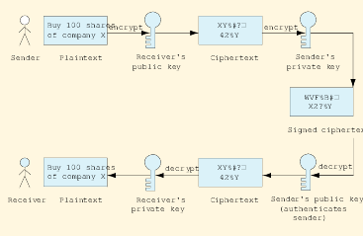
Public Key Cryptography (6)

Slide 34
Public Key Cryptography (6)
RSA (Rivest, Shamir and Adleman, MIT) is the most commonly used public key algorithm commercially.
  it is widely used in web browsers, e-commerce and email systems.
PGP (Pretty Good Privacy, Zimmermann) is widely used to encrypt email message and files

Slide 35
Java Cryptography Extension (JCE)
JCE provides:
  Secret key encryption e.g. 3DES
  Public key algorithms e.g. Diffie-Hellman, RSA
  Use of multiple encryption algorithms and key sizes
  Support for adding new algorithms
  Digital signatures
  Support for Public Key Infrastructure

Slide 36
Java Cryptography Extension (JCE)
Java packages:
java.security.*
java.security.spec.*
javax.crypto.*
java.crypto.spec.*

Slide 37
Java Cryptography Extension (JCE)
Support for:
  Secret key:
    DES
    AES
  Public key
    Diffie-Hellman
    RSA

Slide 38
Digital Signatures (1)
Based on public key cryptography
Authenticates the senders identity
Senders plain text message is used to create a hash value e.g. SHA-1 produces a 160 bit hash value.
Sender uses its private key to encrypt the hash value (aka message digest)
The sender then encrypts the message with the receivers public key
The receiver de-crypts the message with its private key. Applies the same hash function and compares it with the message digest decrypted by the senders public key.

Slide 39
Digital Signatures (2)
An independent time stamping service may be used to sign and date a message as proof that a message was sent at a certain time.
US Government has passed legislation that makes digital signatures as legally binding as written ones

Slide 40
Public Key Infrastructure (1)
One problem with public-key cryptography is that anyone with a set of keys can assume another persons identity.
How does a customer know that a web site belongs to a particular merchant and not to someone masquerading as the site to steal credit card numbers?

Slide 41
Public Key Infrastructure (2)
PKI integrates:
  public-key cryptography
  digital certificates
  certificate authorities
A digital certificate is a digital document that identifies a user and is issued by a certificate authority

Slide 42
Public Key Infrastructure (3)
Digital Certificate includes :
  name of subject (company or individual)
  subjects public key
  serial number
  expiration date
  signature of the trusted authority (e.g. Verisign)
  additional information
The CA signs the certificate by encrypting the subjects public key using its own private key.
CA’s are usually part of a certificate authority hierarchy

Slide 43
Public Key Infrastructure (4)
The longer a key pair is used the more vulnerable the keys are to attack and crypto analysis
Digital certificates have expiration dates , thus forcing the keys to be updated
Revoked or expired keys are placed on a certificate revocation list
In US certificates legally bind certificate owners to transactions involving their certificates

Slide 44
Java Keystores and keytool
keytool utility
  manages and generates keys, certificates and digital signatures
  keys are kept in a keystore
  the key store is password protected

Slide 45
Java Keystore
repository for storing public and private keys
modifying stored keys requires use of password
default keystore located in home/user/.keystore
command line arguments
  -genkey produces private and public key pair
  -export export a certificate
  -import import certificate from trusted source
  -list list all contents of keystore
  -alias <alias_name>
      identify public and private pair for later use

Slide 46
Java Policy Files (1)
Basis of Java security is the Sandbox – the protected environment in which applications and applets run
Users must grant an application to access resources outside of the sandbox.
Sandbox security model
  bytecode verifier
  class loader
  security manager

Slide 47
Java Policy Files (2)
Security policy files are text based and some content is needed to run any applet
Examples
java.security.AllPermission
java.io.FilePermission
java.lang.RuntimePermission
java.net.SocketPermission
java.net.NetPermission

Slide 48
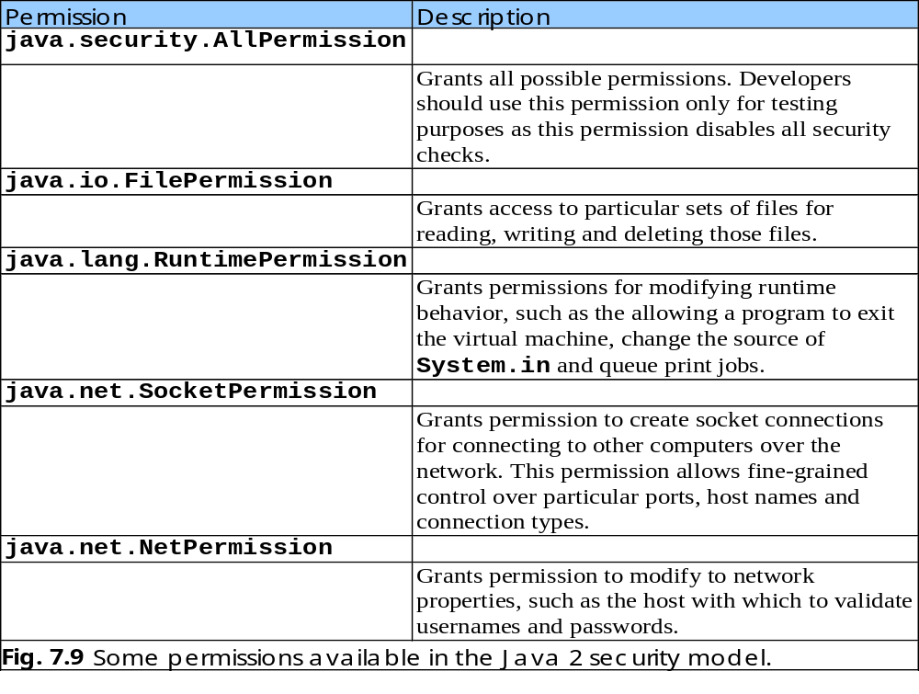

Slide 49
Digital Signatures for Java Code
Java applets run under strict security restrictions
Java applets run in the sandbox by default
Developers who distribute applets with special permissions (e.g. file i/o) must sign the applets with digital signatures
keytool allows developers to generate public/private key pairs using RSA

Slide 50
Authentication (1)
Authentication is verifying users are who they claim to be
Java provides the Java Authentication and Authorization Service (JAAS)
JAAS is a plug in framework that supports:
  Kerberos
  single sign-on

Slide 51
Authentication (2)
Kerberos
  Open source protocol developed at MIT
  Uses secret key cryptography
  Each client shares a secret key with Kerberos
  On logon Kerberous returns a ticket granting ticket (TGT) encrypted with the secret key shared with the client.
  The client decrypts the TGT (authenticating the client) and sends it back to Kerberos
  Kerberos then sends a Service Ticket, which authorises the client to certain services
  Service tickets expire and have to be renewed

Slide 52
Authentication (3)
Single Sign On
Allows user to sign on once with a single password and access multiple applications
  Workstation logon scripts
  Authentication server scripts
  Tokens

Slide 53
Secure Sockets Layer (SSL)
Most e-businesses use SSL for secure online transactions
SSL secures WWW connections and is built into most Web browsers
The non-proprietary SSL protocol was developed by Netscape
It operated between TCP/IP and the application software

Slide 54
Secure Sockets Layer (2)
SSL implement public-key technology using the RSA algorithm and digital certificates to authenticate the server in the transaction and to protect private information that passes from one party to the other
SSL does not require authentication of the client – credit card numbers are considered sufficient

Slide 55
Secure Sockets Layer (3)
The client sends a message to the server
The server responds and sends its digital certificate to the client for authentication
The client and server negotiate a secret session key to continue the transaction
Message that follow are broken into blocks, compressed and encrypted
Note that data stored on the server may be at risk if it is not secure!

Slide 56
Secure Sockets Layer (4)
Java provides support for SSL through the Java Secure Socket Extension (JSSE)

